Slide 1

HCI Admin Module Training
By Seid M 2020
JMC-ICT

Slide 2
Contents to covered
Access HCI
User Management
System Setting
Configuration
Patient Registration
Create encounter and view status
Service payment info
Reports
Communication
Noticeboard
Backup and restore
Multiple Excerises

Slide 3
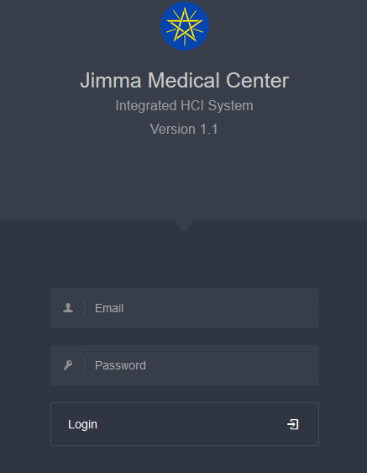


Accessing HCI
Web Application
Accessible through any browser
To Login to IMS, you need:
Email
Password
10.142.65.36/hci.ju.edu.et

Slide 4
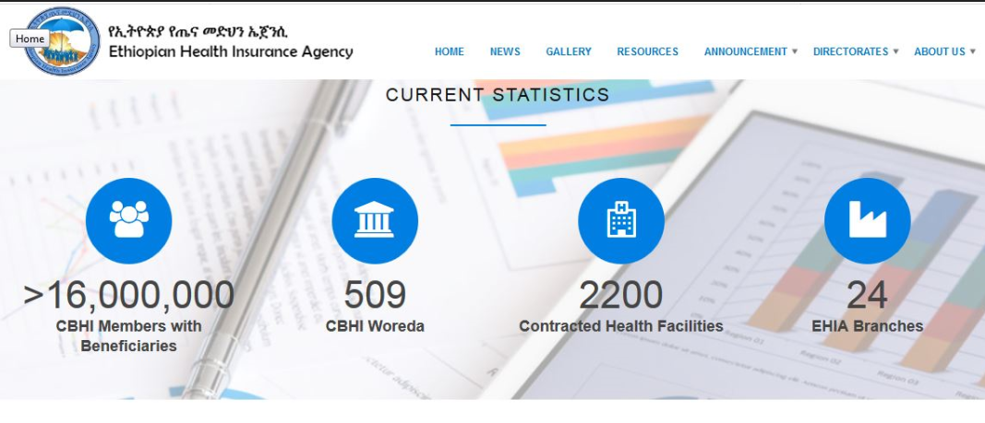
Adapted from EHIA Website, 2012

Slide 5
Super Users
Administrator
Super Administrator
User management
except root user
Account recovery
Monitor active user
Check access control list
Can backup database
Can change system setting like system name.
It is root user
Can shutdown the system/maintenance mode On/Off

Slide 6
Other Users
Accountant
Users
Prepare reports monthly, quarterly.
Monitor user activities.
Register new Region, Zone District, Kebele.
Create new agreement
View all encounter status
Send and Received message
Register new patient with credit service, CBHI and Health care finance.
Add service charge info
Create new encounter.
Discharge
Edit patient info.
View their own registrations,encounters.
Send and receive message with Accountant

Slide 7
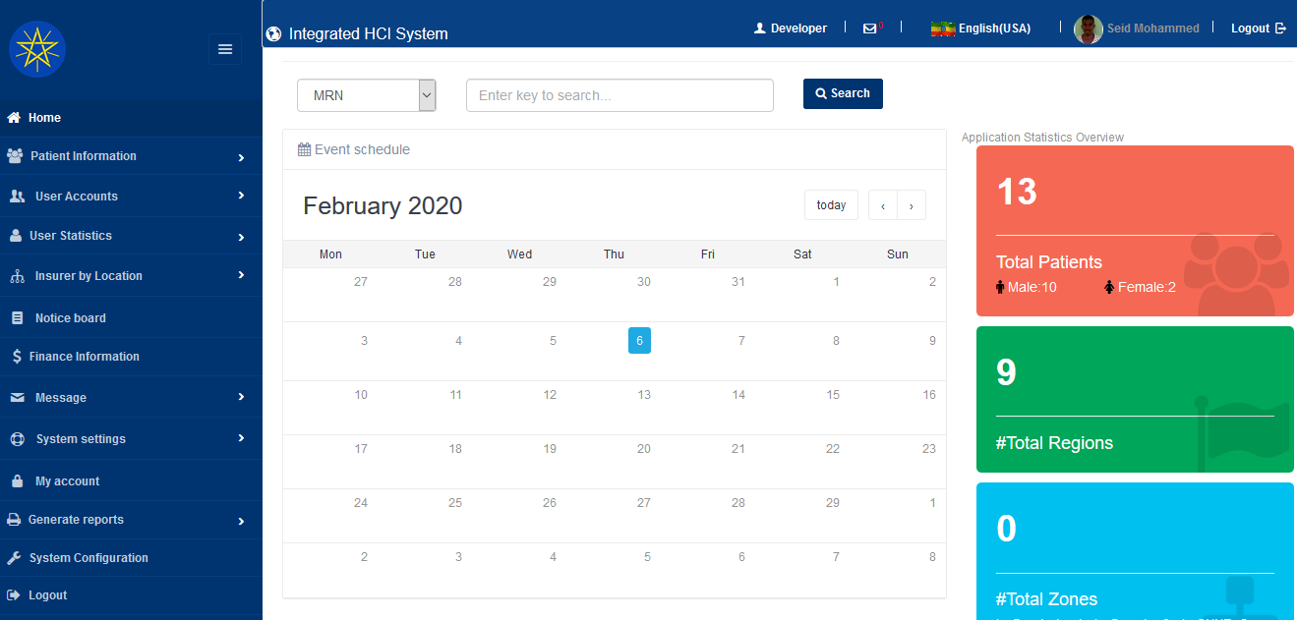
Super Admin Home Page

Slide 8
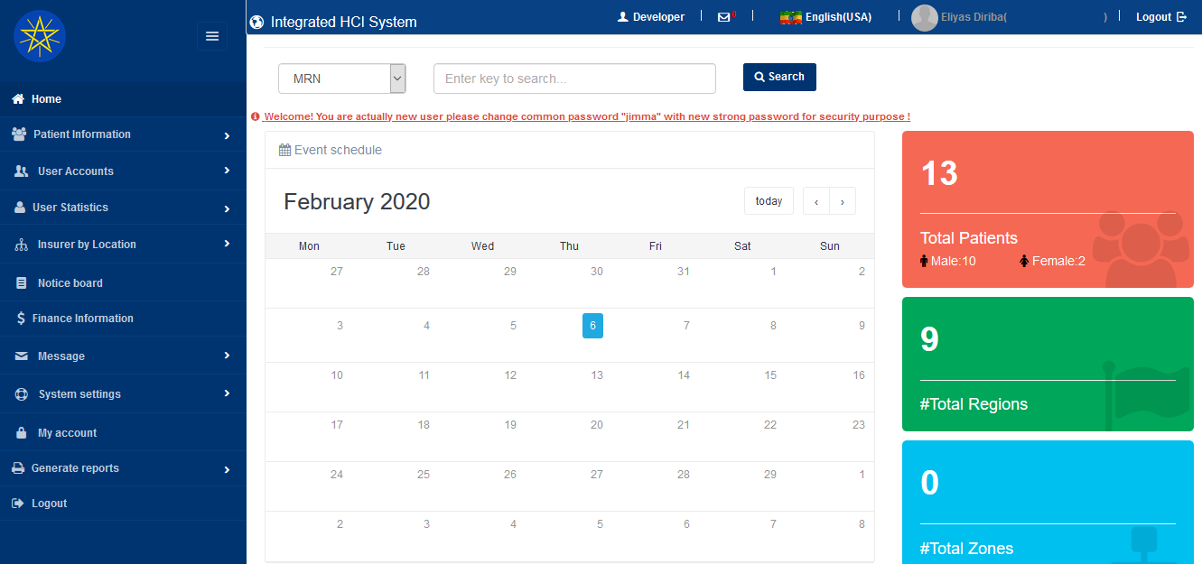
System Administrator

Slide 9

Accountant/Finance head

Slide 10

User Home Page

Slide 11
Patient Classes(Who don’t pay from pocket
Health care finance patients
-Who get healthcare via legal letter
Community based health insurance(CBHI)
- Include family on CBHI Book from Woreda
Credit service
-Employee
-Students
NB: naming of system “hci.ju.edu.et”

Slide 12
General Objective
Create patient medical profile
Record patient encounter
Calculate fee by service type and encounter date
Create agreement with woreda and organization
Generate payment request report by
-Monthly
-Quarterly
For personal, group, single agreed organization or district

Slide 13
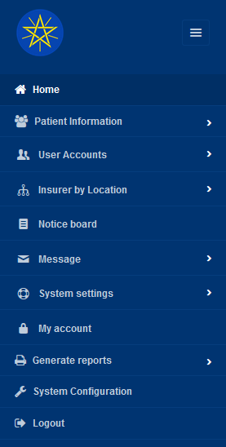
Navigation bar
Patient info Users management

Slide 14
Exercise 1
Register new user
Use you full information :User ID, (Fname & Lname), Email: phone, Sex, Role(User, admin or accountant).
Enable/ Disable
Reinitialize password
Update profile photo and phone number last two digit with 01

Slide 15
Exercise 2- at least 5 patients each user
Register new cbhi patient- limu kosa,limuseka, jimma, Oromia
Credit service - JIT, airport, jimma, Oromia
Health care – select bunobedele,elibabor or Kaffa zone
Create encounter for each
Add service payment info
Note:
-Student ID :1213/06 -CBHI #ID : 10/12546
-Employee: 1080332011 -Letter No: HUB/25463
-MRN: 125485

Slide 16
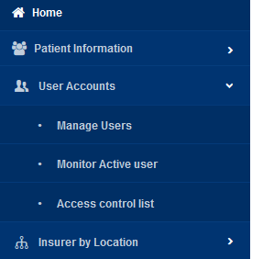
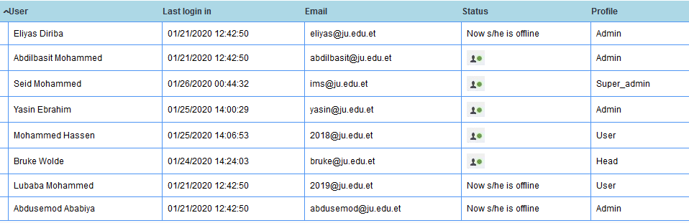
Other Tasks
Active users

Slide 17
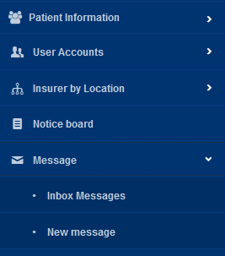
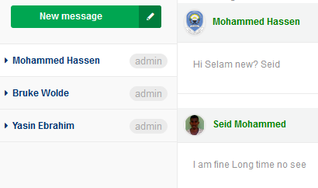
Communication
Inbox Message
Send message

Slide 18
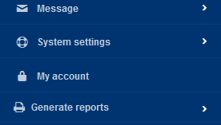
Edit you profile
Click my account or you name on header

Slide 19
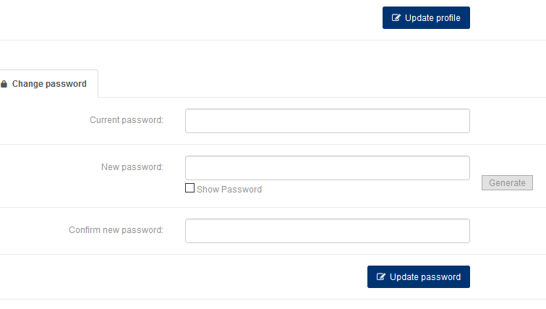
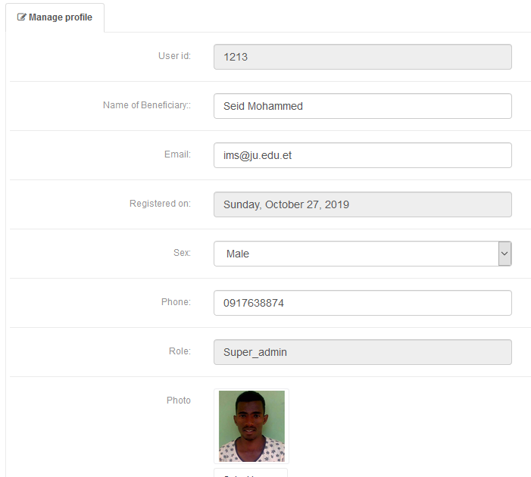
Edit you profile…

Slide 20
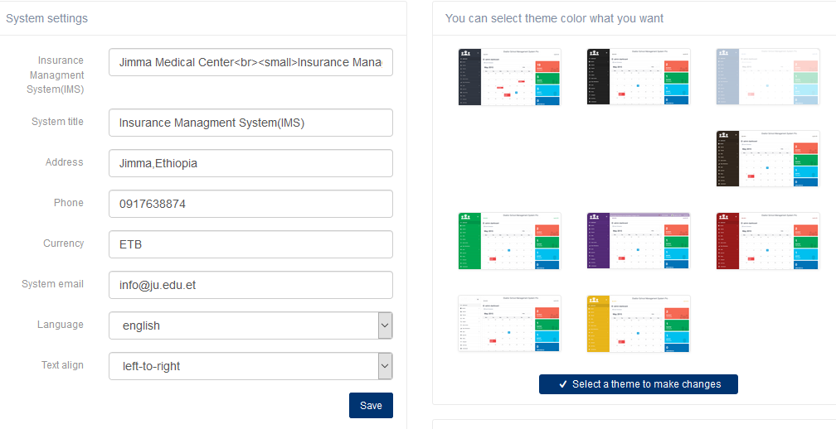
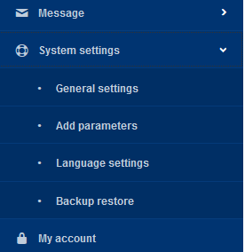
Configuration
Click here Select theme

Slide 21
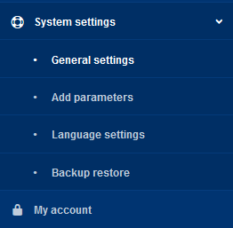
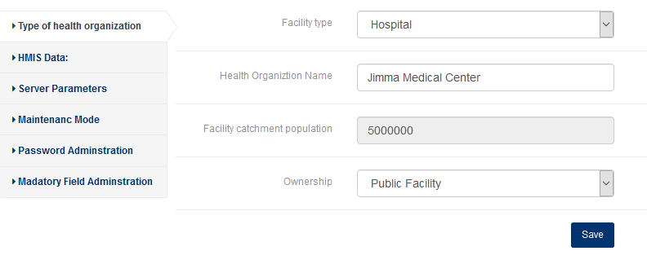
Configuration…
Click add parameter

Slide 22
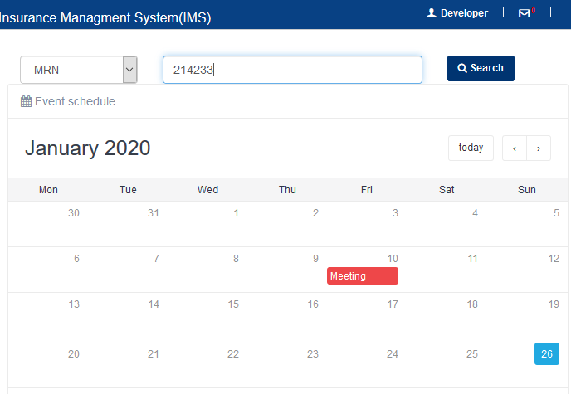
Patient Management module
Click search button or Hit Enter
Type card number
Notice board
Ex: meeting on 10 Jan,2020

Slide 23
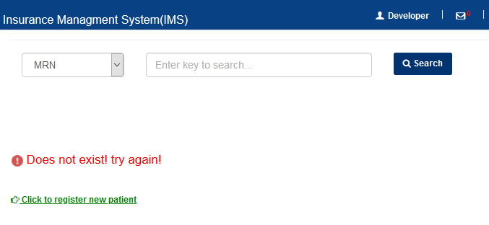
Unsuccessful Search result
No patient associated with entered MRN
If new, click below green link to register as new patient

Slide 24
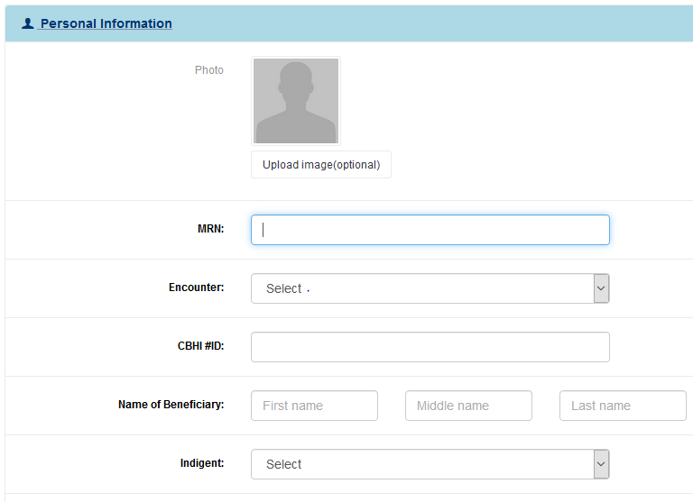
New patient Registration

Slide 25
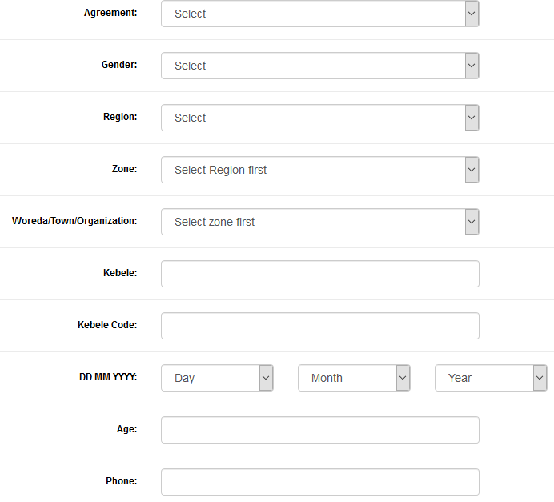


Slide 26
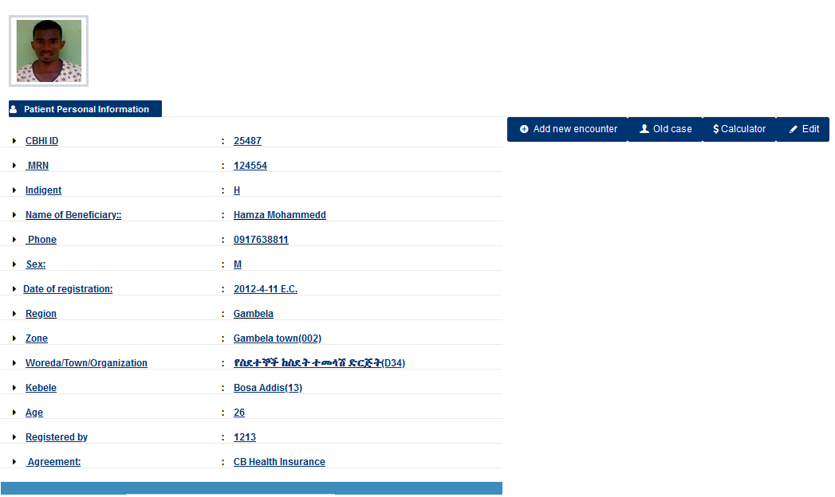
Successful Search result

Slide 27
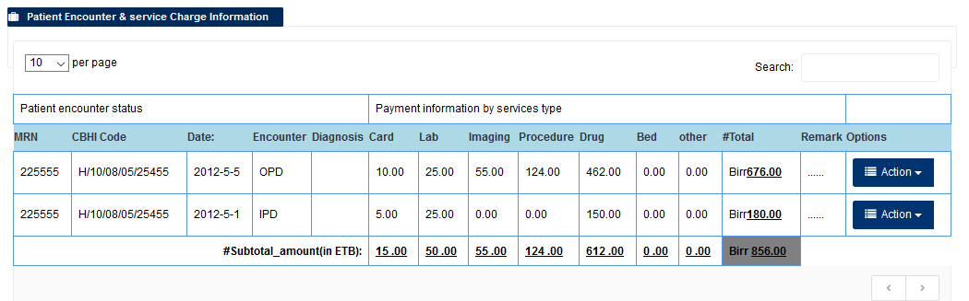
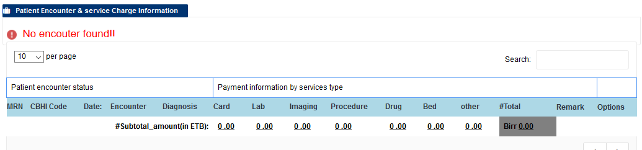
Successful Search result…

Slide 28
Create new encounter
Click here

Slide 29
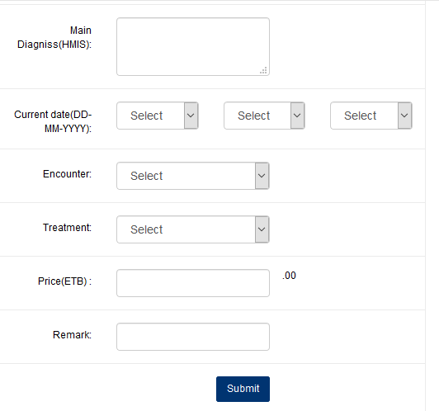
Create new encounter….
Encounter (OPD and IPD)
Treatment: Card
Price 5 or 10
Current date: DD-MM-YYYY

Slide 30
Old case or appointment
Click here

Slide 31
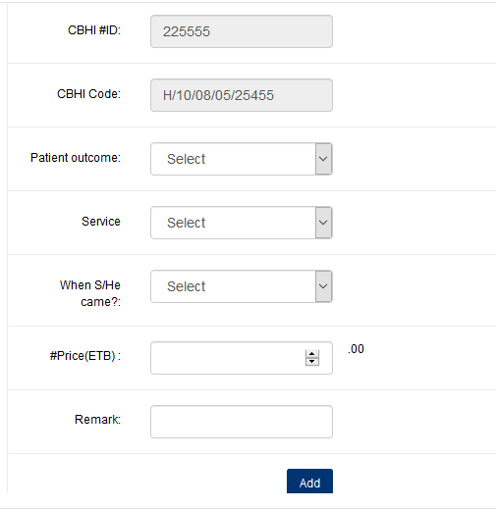
Old case… (H/10/08/05/25455)
(H/10/08/05/25455)
Outcome
Service
Date coming
Price for service
Fill Remark if you select others

